Slide 1
Case Study Indian e-commerce customers
Deepak Kumar

Slide 2
Contents
1. Introduction
2. Overview
3. Data Analysis
4. Exploratory Data Analysis
5. Observations
6. Conclusion

Slide 3
Introduction -Customer satisfaction store
Customer satisfaction has emerged as one of the most important factors that guarantee the success of online store.
Key stimulant of purchase
Repurchase intentions and customer
Comprehensive review of the literature, theories and models

Slide 4
Major Factors for success
Service quality
System quality
Information quality
Trust
Net benefit

Slide 5
Data Exploratory Analysis
Customer Information
Utilitarian value
Hedonic Value
Customer Satisfaction

Slide 6

1. Customer Information
It is individually identifiable information about a Customer or the purchase by a Customer of the services or products of a Party.

Slide 7
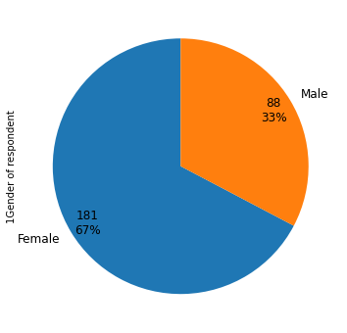

Gender

Slide 8
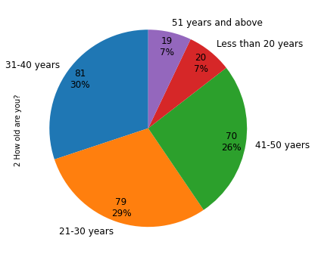

Age

Slide 9

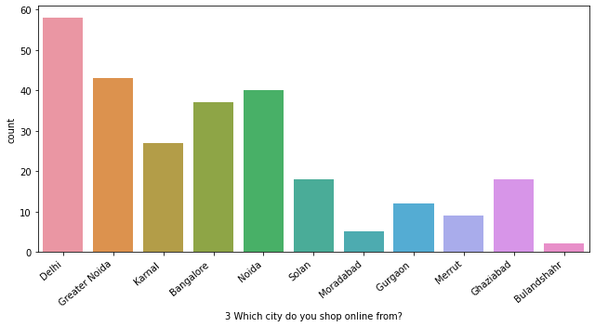
Customer Location

Slide 10
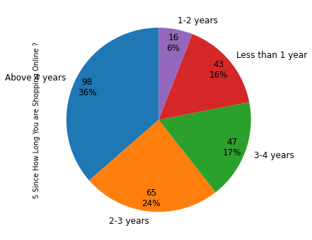

How Long a Customer is doing Shopping Online

Slide 11
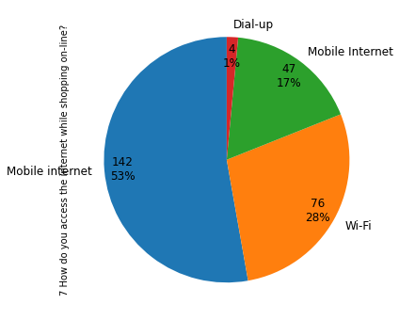

How do Customer access Internet

Slide 12
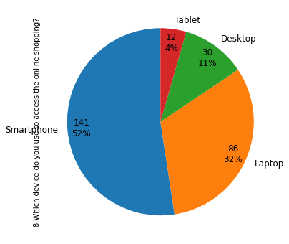

Device used

Slide 13
2. Utilitarian Values
Utilitarian value is a value that customer receives based on task- related and rational consumption behavior, functional, cognitive, and a means to an end
Utilitarian needs implies that consumers will emphasize the objective, tangible aspects of products.

Slide 14
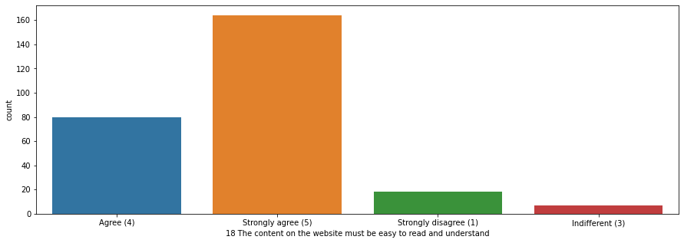
Easy to Read and Understand
Most of the participants agree and strongly agree that content on the website must be easy to read and understand

Slide 15
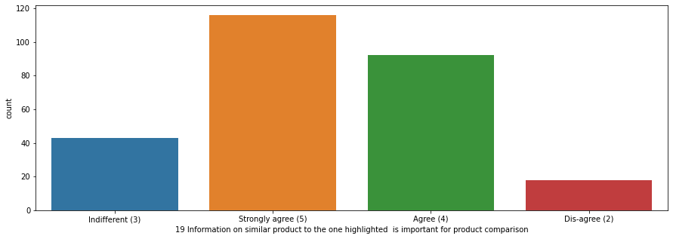
Information on similar Product
For Product Information, is the information on similar product to the one highlighted important

Slide 16
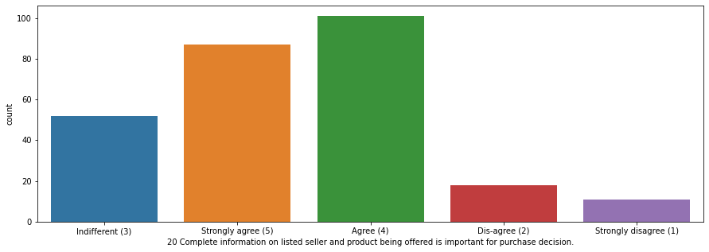
Seller and Product Information
Most of the participants agrees that complete information on listed seller and product being offered for purchase decision

Slide 17
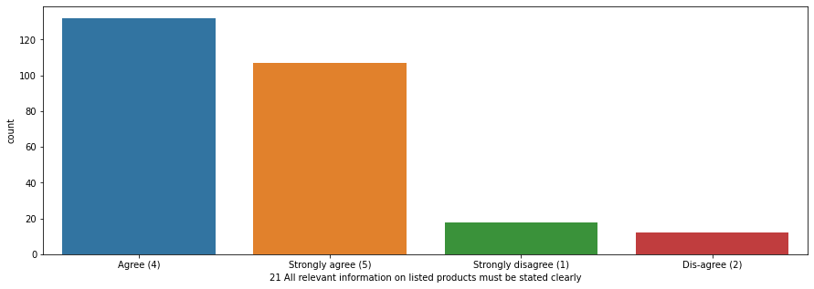
Relevant Information
Most of the participants agrees that relevant information on listed products must be stated clearly

Slide 18
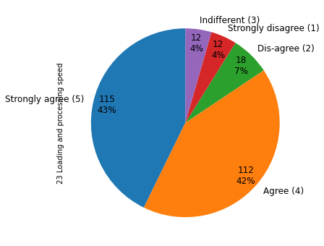
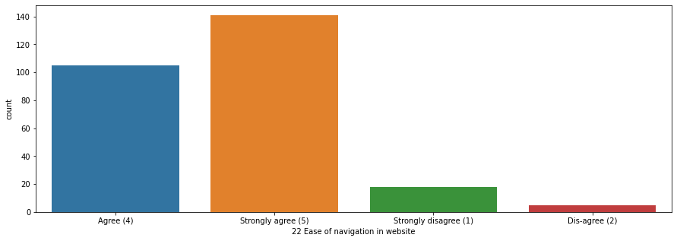
Loading Speed and Navigation
Most of the participants agrees that loading speed, ease of navigation,latenecy is an important factor for customer satisfaction.

Slide 19
3. Hedonic value
Hedonic value is defined as that value a customer receives based on the subject experience of fun and playfulness
It in turn, helps to generate long-lasting relationships with customers and it is important for developing loyal customers and in building close emotional links with target customers

Slide 20
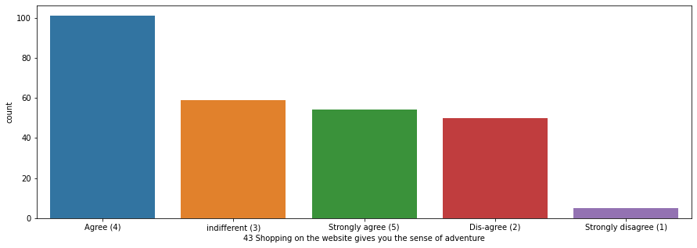
Sense of Adventure
Most of the customer agrees to the fact that shopping on the website gives them sense of adventure

Slide 21
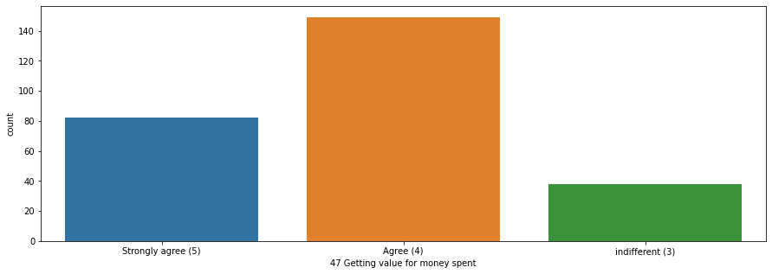
Value for money spent
Most of the customer agrees to the fact that they get value for money they spent in online shopping.

Slide 22

4. Customer Satisfaction
Customer satisfaction is defined as a measurement that determines how happy customers are with a company's products, services, and capabilities.
Customer satisfaction information, including surveys and ratings, can help a company determine how to best improve or changes its products and services.

Slide 23
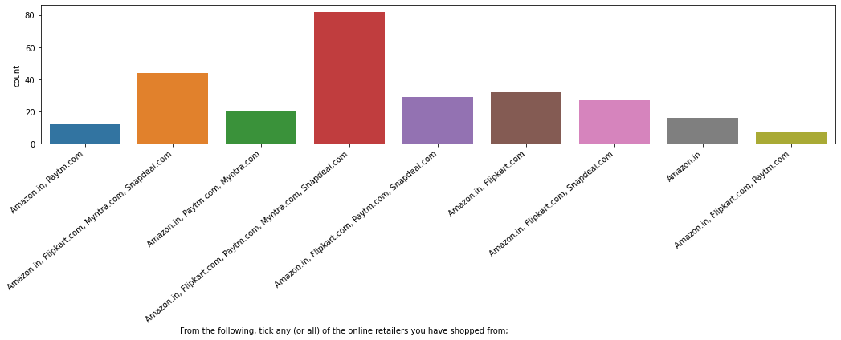
Online Retailers
Amazon and flipkart are the most preffered online retailer

Slide 24
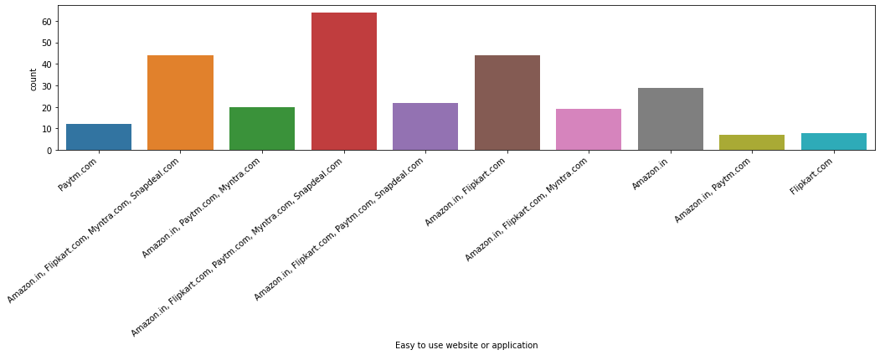
Which site is easy to use
Amazon and flipkart are most user friendly websites

Slide 25
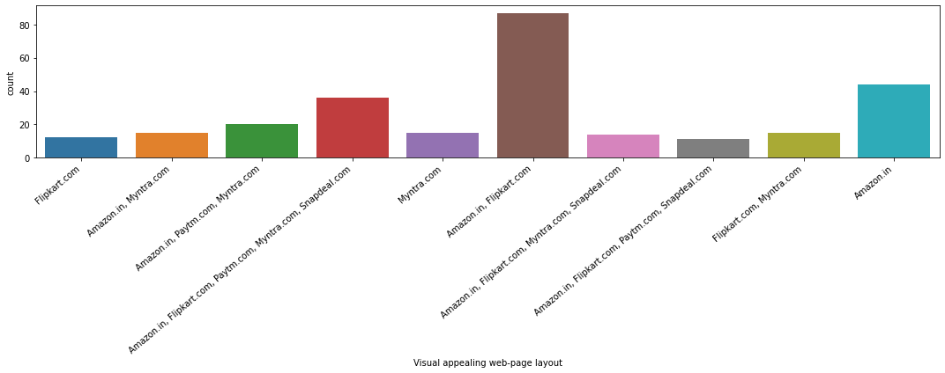
Visual Appealing
Amazon and flipkart are most visual appealing websites

Slide 26
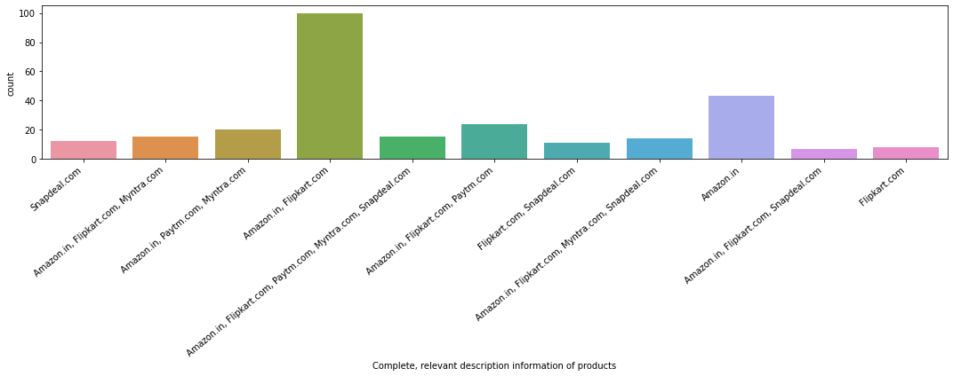
Product Information
Complete relevant description information of products are available on amazon and flipkart.

Slide 27
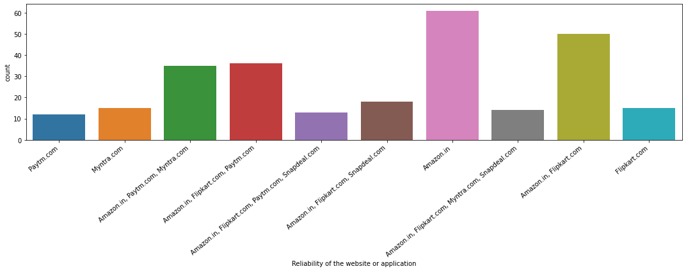
Reliability
When it comes to Reliability, amazon and flipkart are most reliable.

Slide 28
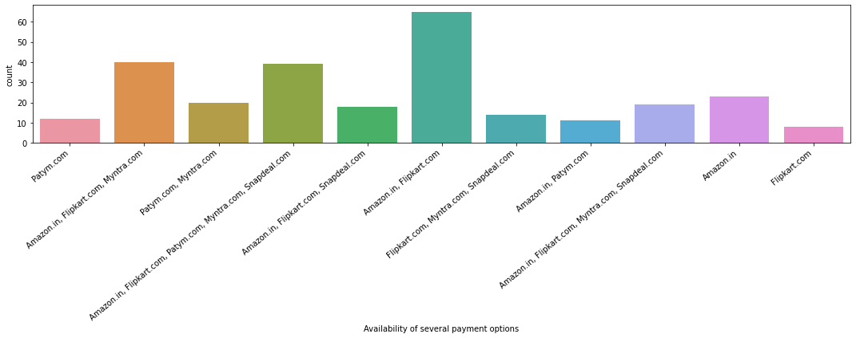
Payment Option
When it comes to Payments, amazon and flipkart have most payment options available.

Slide 29
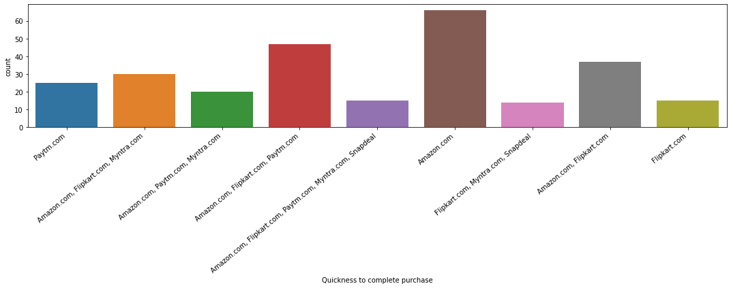
Quickness
Customers purchase quickly from amazon because the site is easy to navigate, loads faster, informative, reliable, more payment options etc.

Slide 30
Observations
80% of the total participants are between the age group of 21-50 years, in which 21-30 years are 79 members, 31-40 years are 81 members and 41-50 years are 70 members.
Participants from Delhi, Noida, Greater Noida and Bangalore seem to be shopping in higher range when considered to other cities included for the survey.
This may be due to the fact that many companies and colleges are around this area.
Around 65% of the total population in the dataset are shopping online for more than 3 years.
Major part of the customers seems to be shopping less than 10 times a year.
Most of the customers seem to be using Smart Phone and Mobile Internet for shopping. This means the E-commerce website should be compatible in all kinds of smart phone browsers to attract a lot more customers.
Many used search engine to find their favorite online store, which means the E-commerce website should be search engine optimized on all times.
Also after the search engine, E-commerce application seems to be the second favorite mode of logging in to the website. This means the application should be server and software supported at all times.
Most of the population seem to be spending an average of more than 15mins in the website for shopping.
Most population prefer to pay via Credit/ Debit cards while shopping online.
Most of the population available in the dataset abandon the shopping cart to find Better alternative offer,20% for Promo code not applicable,14% for change in price, 12% for lack of trust and 5% for no preferred mode of payment.
The content must be easily available and should be more informative.

Slide 31
Observations (continued)
Amazon.in and Flipkart.com has a visually appealing web-page layout.
Amazon.in and Flipkart.com has a wide variety of products on offers.
Amazon.in and Flipkart.com has complete and relevant description information of products compared to all other websites.
Amazon. In, Flipkart.com, Snapdeal.com, paytm.com, myntra.com has fastest loading websites. Hence there is no latency.
Amazon.in and Flipkart.com has the high reliability of the customer.
Amazon.in, Flipkart.com has quickness towards completing the purchase.
Amazon. In, Flipkart.com, Snapdeal.com has availability of several payment options.
Amazon.in and Flipkart.com has speedy order delivery.
According to customers the privacy and security of customer financial information is maintained by Amazon.in and Flipkart.com.
Amazon. In, Flipkart.com, Snapdeal.com has a Perceived Trustworthiness.
Presence of online assistance through multi-channel is mostly provided by Amazon.in, Flipkart.com, and Snapdeal.com.
Longer time to get logged in (promotion, sales period): Amazon.in, Flipkart.com, Paytm.com.
Amazon.in, Flipkart.com, Myntra.com, Snapdeal.com takes longer time in displaying graphics and photos.

Slide 32

Conclusion
On the basis of the above factors we see that the below websites are doing extremely well in their performance on customer satisfaction and retention
Also they are keeping the pattern trend of shopping of the customers which helps them to suggest products.
Amazon.in
Flipkart.com

Slide 33


